Slide 1
Let’s Grow Your Rotary Club!
Herb Klotz, D7430
Allentown West Rotary Club
Zone 32 Rotary Coordinator 2021-24
Title Page Option

Slide 2
Meet your 2021-22 membership team
District Membership Chairs
  7210 – Tony Marmo (tony@normanstaffing.com)
  7230 – Marty Schulman (rotaryd7230membershipchair.org)
  7255 – Kevin Bagnasco (kevinbagnasco@gmail.com)
  7410 – Samantha Maruzzelli (samanthamaruzzlli@gmail.com)
  7475 – Steve Goldberg (stegold94@aol.com)
  7490 – Joe Dino (josephddinojr@optonline.net) & JoEllen Knie (joellenknie@gmail.com)

Slide 3
Meet your 2021-22 membership team
Assistant Rotary Coordinators (vibrant clubs)
  Cecily Smith (rotary7230pr@gmail.com) Districts 7210, 7230, 7255
  Ray Freaney (rayfreaney@gmail.com) Districts 7410, 7475, 7490
Innovative Club Advocate (starting new clubs & satellites)
  Cecily Smith (rotary7230pr@gmail.com)

Slide 4
Presentation & Discussion Topics
Data-Driven Diagnostic for Club Membership Growth
Proven Actions to Grow Membership in Your Rotary Club
Breakout Sessions to Share and Discuss Ideas for Membership Growth

Slide 5
Club Membership Study
(Mid-Atlantic USA, Zone 33)
Goal:
Predict a Rotary club’s current and future membership growth successes and challenges.
Basis:
6 years of membership trends from 16 North America Districts and 846 Rotary Clubs

Slide 6
RESULTS
Likelihood of membership growth is not RANDOM
  Growing Clubs tend to grow year after year (80+% likelihood)
  Declining Clubs tend to decline year after year (80+% likelihood)
  Clubs holding their own can go either way (fragile balance)
Unless something changes!

Slide 7
Your Club’s 3 Year History
2017-2020
Avg. Attraction Rate = % of new members joining club
Avg. Attrition Rate = % of members leaving club

Slide 8
Essential lessons
Attrition is REAL
  Attrition % = 100% - Retention %
  Rotary International Average = 14.1%
  Desired Goal = 8-10%
  Attrition Rates >15% Need Attention
Attraction Rate must Exceed Attrition rate to Grow

Slide 9
AttrACTION vs. Attrition
1 – Growth Culture
129 Clubs
(11%)
Key
3 – High Turnover
404 Clubs
(35%)
Growing Membership
High
Fragile Balance
Attraction Rate (%)
Declining Membership
12%
2 - Stable
296 Clubs
(26%)
4 – Danger Zone
328 Clubs
(28%)
Low
Low
12%
High
Attrition Rate (%)

Slide 10
Quadrant 1
High AttrACTION, Low Attrition
1 – Growth Culture
129 Clubs
(11%)
Key
Growing Membership
High
Fragile Balance
Attraction Rate (%)
Declining Membership
12%
Keep doing what you’re doing
Keep improving
Share ideas with other clubs
Low
Low
12%
High
Attrition Rate (%)

Slide 11
Quadrant 2
Low Attrition, LOW Attraction
Key
Keep engaging your members
Focus on Attraction
            Service Projects
            Social Media
            Member Attraction Events
            Alternate Experiences
            Flexibility
Growing Membership
High
Fragile Balance
Attraction Rate (%)
12%
Declining Membership
2 - Stable
296 Clubs
(26%)
Low
Low
12%
High
Attrition Rate (%)

Slide 12
Quadrant 3
HIGH Attrition, High Attraction
Key
Keep up Your Member Attraction Activities
Focus on Member Engagement
  Club Culture
  Meaningful Projects
  Family Events
  Flexibility
  Alternate Experiences
3 – High Turnover
404 Clubs
(35%)
Growing Membership
High
Fragile Balance
Attraction Rate (%)
Declining Membership
12%
Low
Low
12%
High
Attrition Rate (%)

Slide 13
Quadrant 4
HIGH Attrition, LOW Attraction
Initial Focus on Member Engagement
  Club Culture
  Alternate Experiences
  Meaningful Projects
  Family Events
  Flexibility
Key
Growing Membership
High
Fragile Balance
Attraction Rate (%)
12%
Declining Membership
Then Focus on Attraction
  Social Media
  Member Attraction Events
4 – Danger Zone
328 Clubs
(28%)
Low
Low
12%
High
Attrition Rate (%)

Slide 14
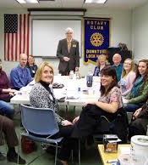
Is your Club MEETING Attractive?
Are your “traditions” welcoming and appreciated by newcomers?
Do potential Rotarians come to a few meetings and commit?
Does your membership “look like” your community?
Do club members talk in “code” (acronyms, Rotary lingo) or is your language inclusive?

Slide 15
Approaches to Grow your Rotary Club
Membership Growth Study of
Three Eastern Pennsylvania Districts
(~150 clubs)
Title Page Option

Slide 16

Top Reasons for Membership Growth
  Clear Membership Goals and Plan
  Strong Public Image Campaign/Active Social Media
  Membership Attraction Events including Mixers / Growth Culture
  Flexibility (Membership Types, Dues Structure, attendance, etc …)
  Alternative Meeting or Satellite Club

Slide 17

Clubs with Significant Growth (>10 net increase in a year)
  90% added an Alternative Meeting or Satellite Club
  90% had a focused Social Media or Marketing Campaign
  90% held Attraction Events or Membership Drives
  Most clubs in this category added 10+ net in consecutive years

Slide 18


Attracting New Members
Start with a Goal and a Plan

Slide 19


Strong Public Image and social media Presence
Club should be seen as a positive doer in your community

Slide 20
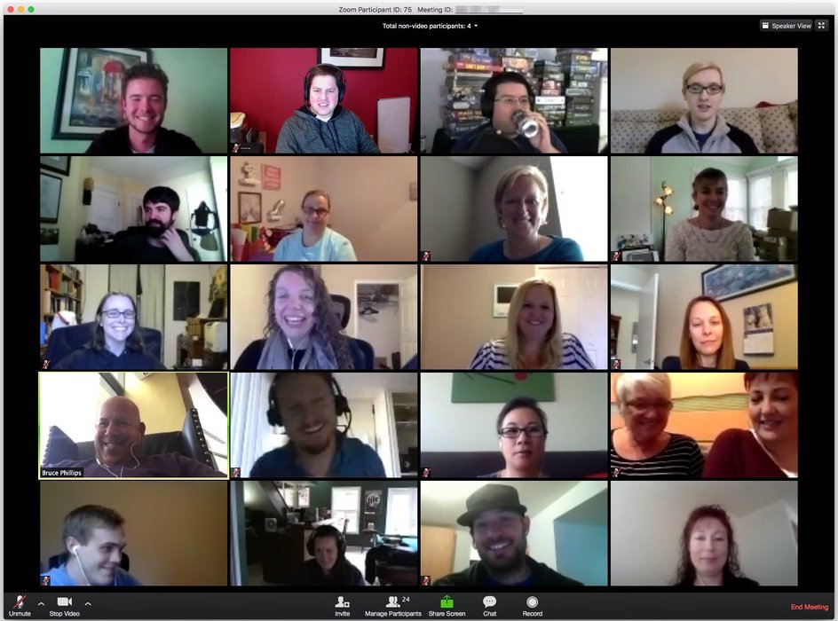
Attracting New Members in the COVID-19 World
What have your clubs learned from Zoom meetings?
It’s awesome to invite speakers from anywhere!
It’s possible to meet without a meal
Fellowship can take place at a club service project

Slide 21

Hold a business mixer or cocktail party (after COVID?)
Sign-in sheet for all attendees
Ask guests and Rotarians to do short intros
Rotary is a soft sell. Start by building a relationship
mixers
A Helpful Networking & Membership Tool

Slide 22

Flexibility
Alternate Membership Types / Dues Structures
Corporate, Family, Young Professional, Senior, Service, …
Alternate meeting times and customs
It’s not about the meal!
Focus on service, not meetings
Invite potential members to service project rather than a meeting
Attendance vs. Engagement
Focus on Engagement!
Make the Rules Simple

Slide 23
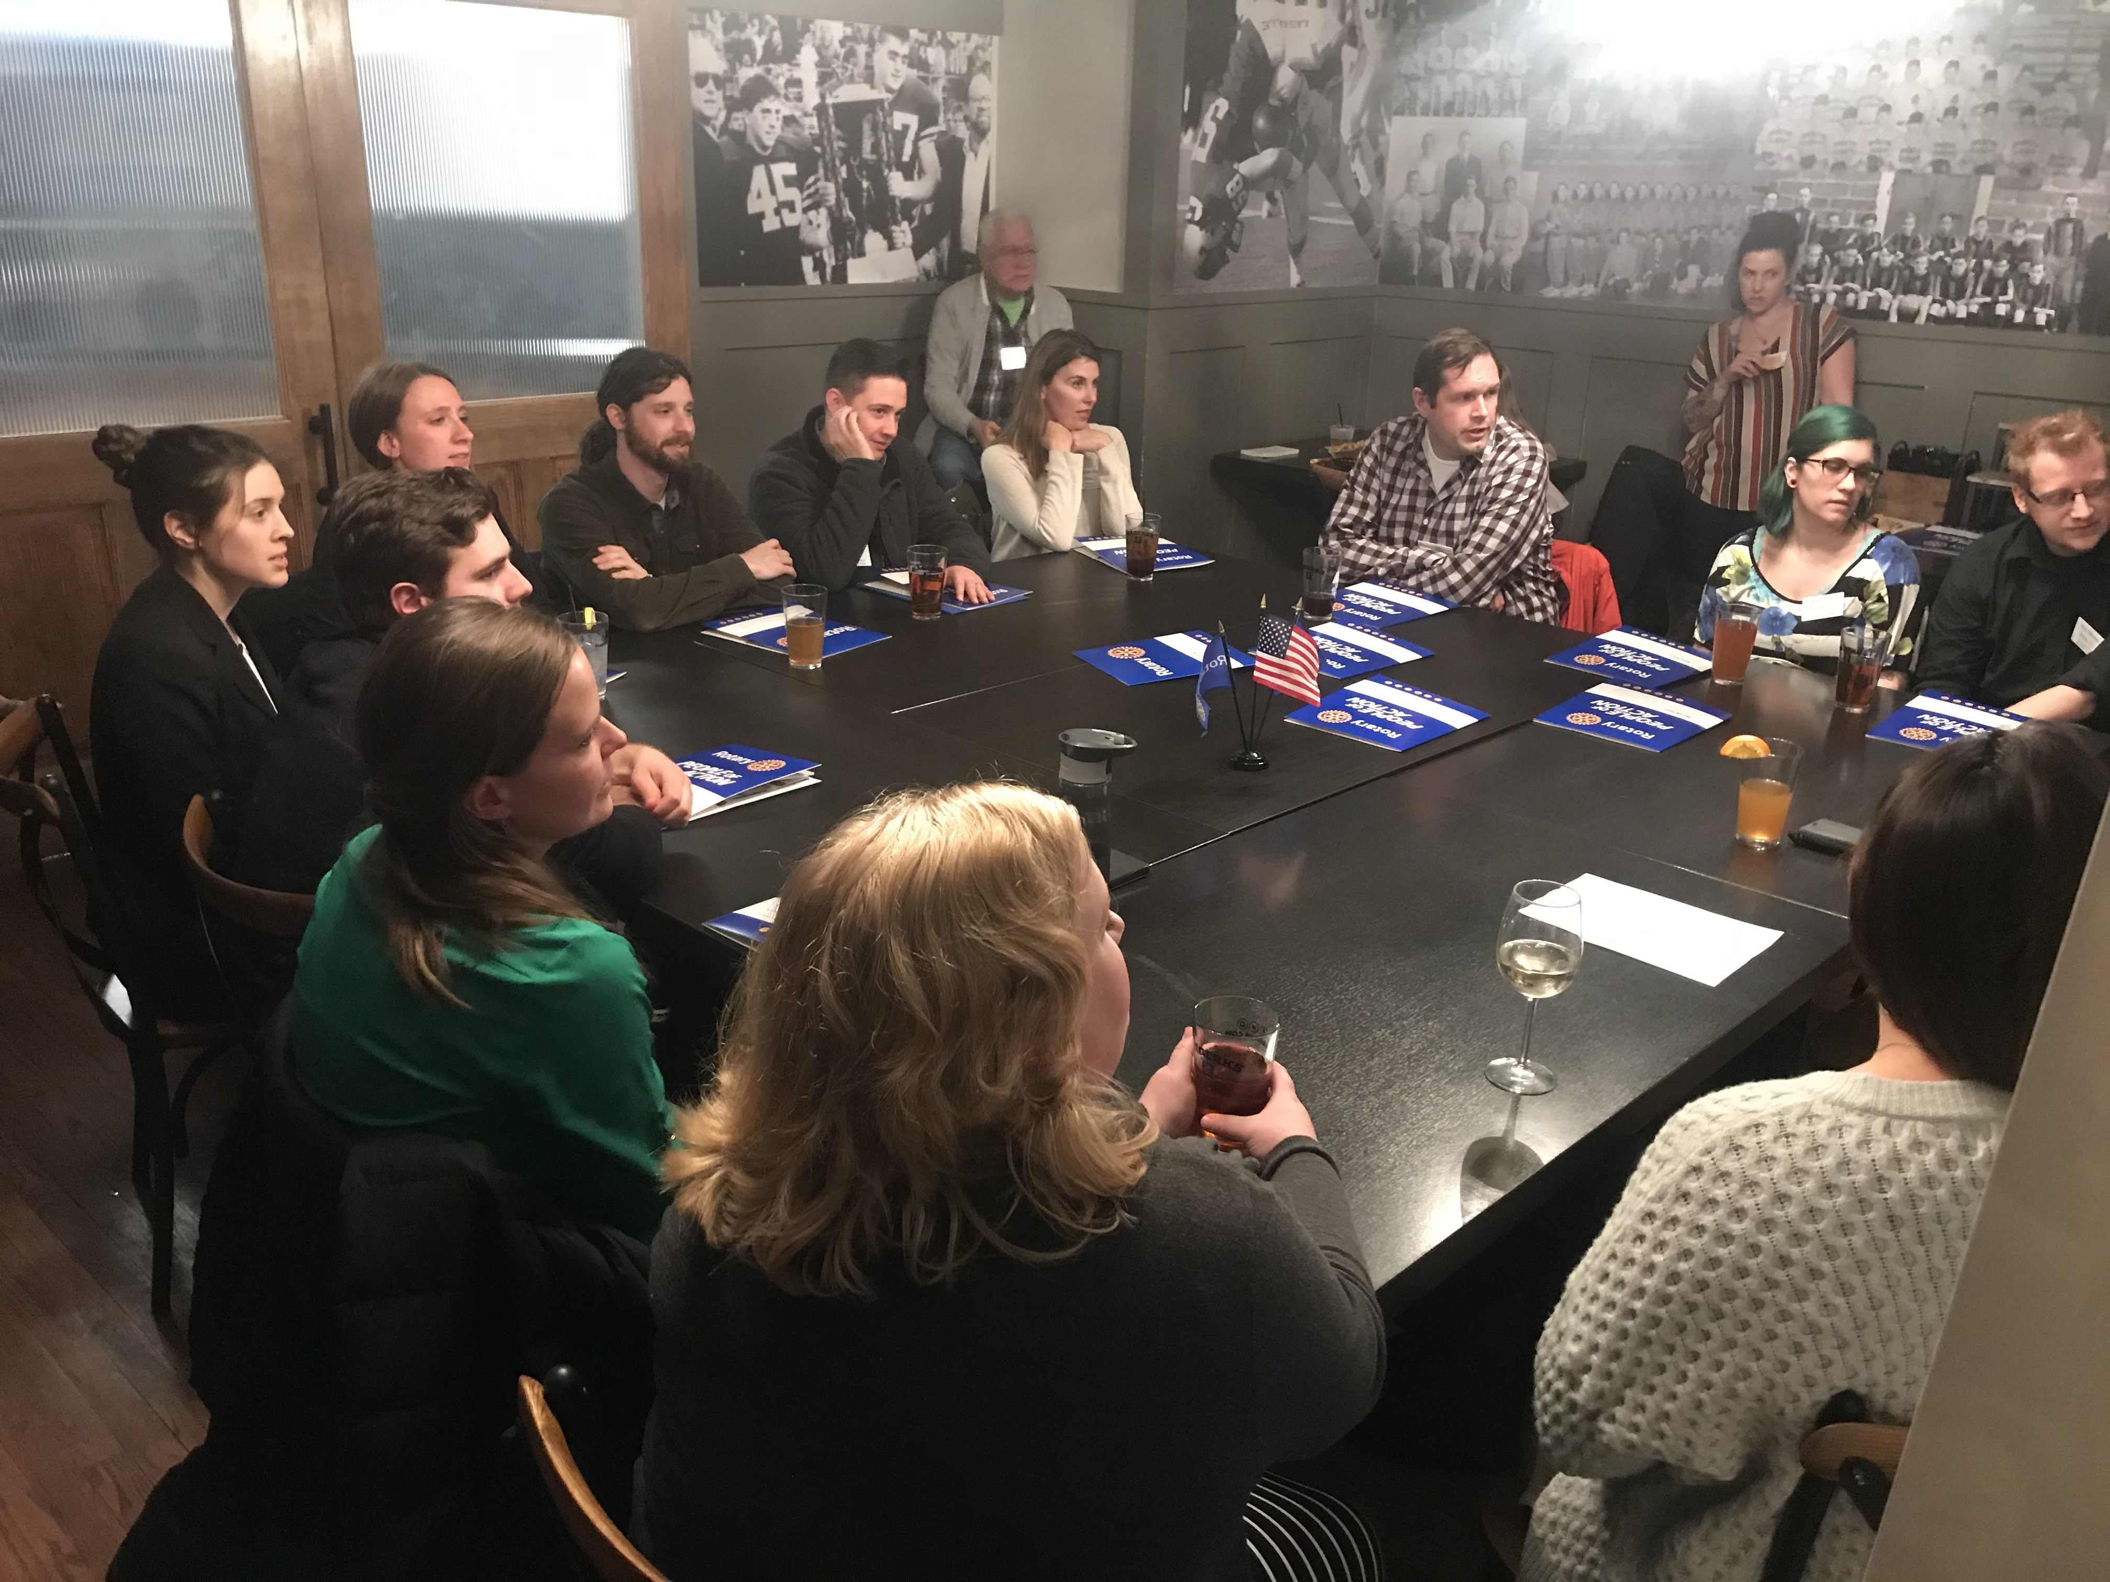
New types of clubs
Focus on different demographics
Alternate Meeting Time
Adjacent Community
Young Professionals
Service Group
Common Cause
Common Culture
Rotary Alumni
What Else???

Slide 24

Let’s Grow Rotary!
Herb Klotz – Rotary Coordinator 2021-22
herbk.rotary@gmail.com

